Slide 1
SPI

Slide 2
SPI = Serial Peripheral interface
Requires 4 data lines
Each device on the bus required an additional GPIO pin
Faster than I2C

Slide 3
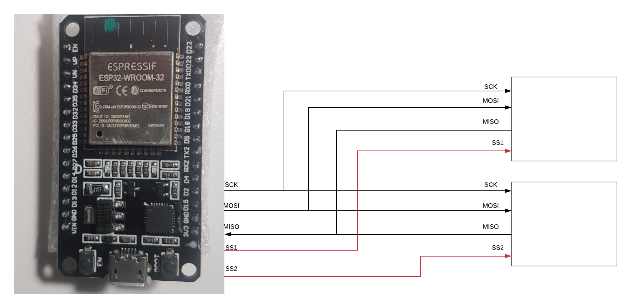
Spi bus

Slide 4
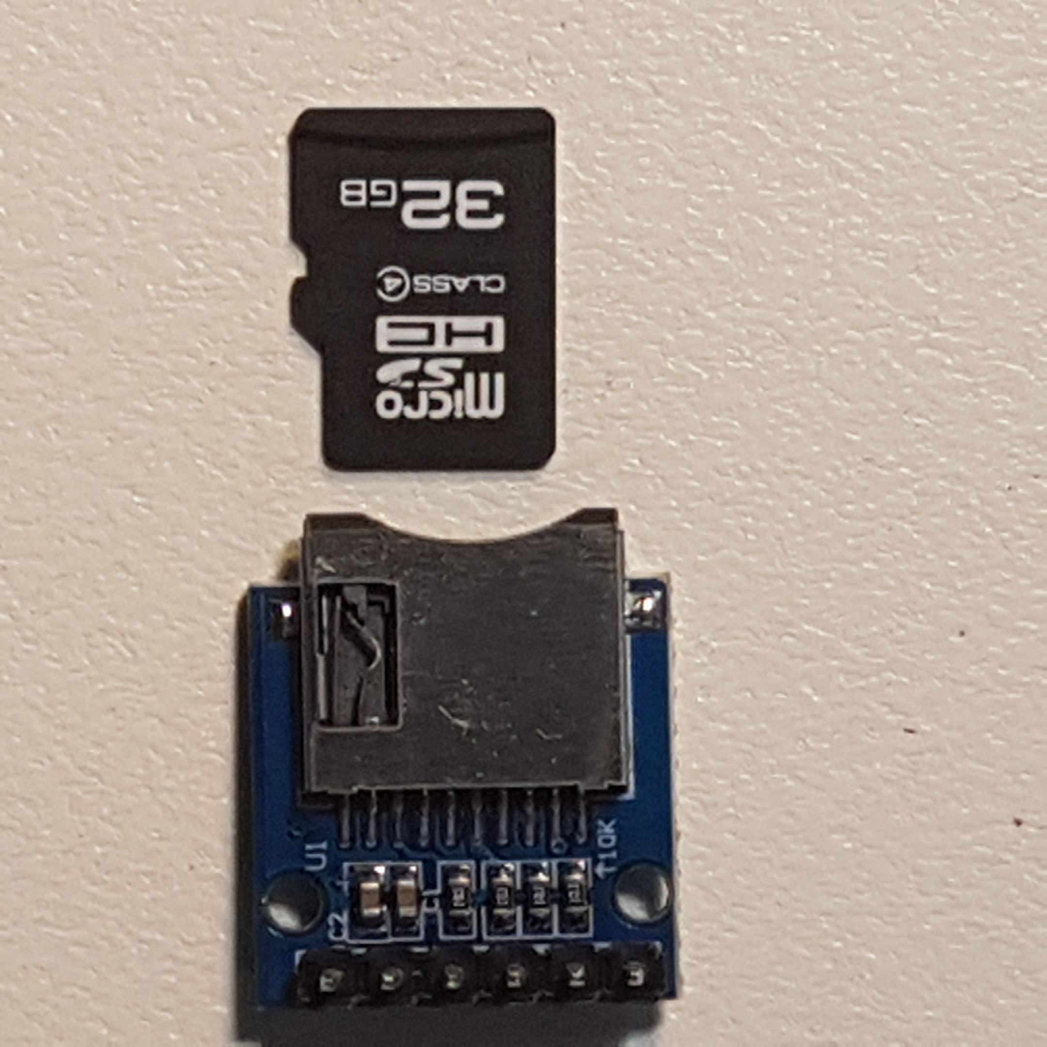
Sd card
Works with SPI
Extend the memory of the ESP32
Enables file transfer between PC and chip

Slide 5
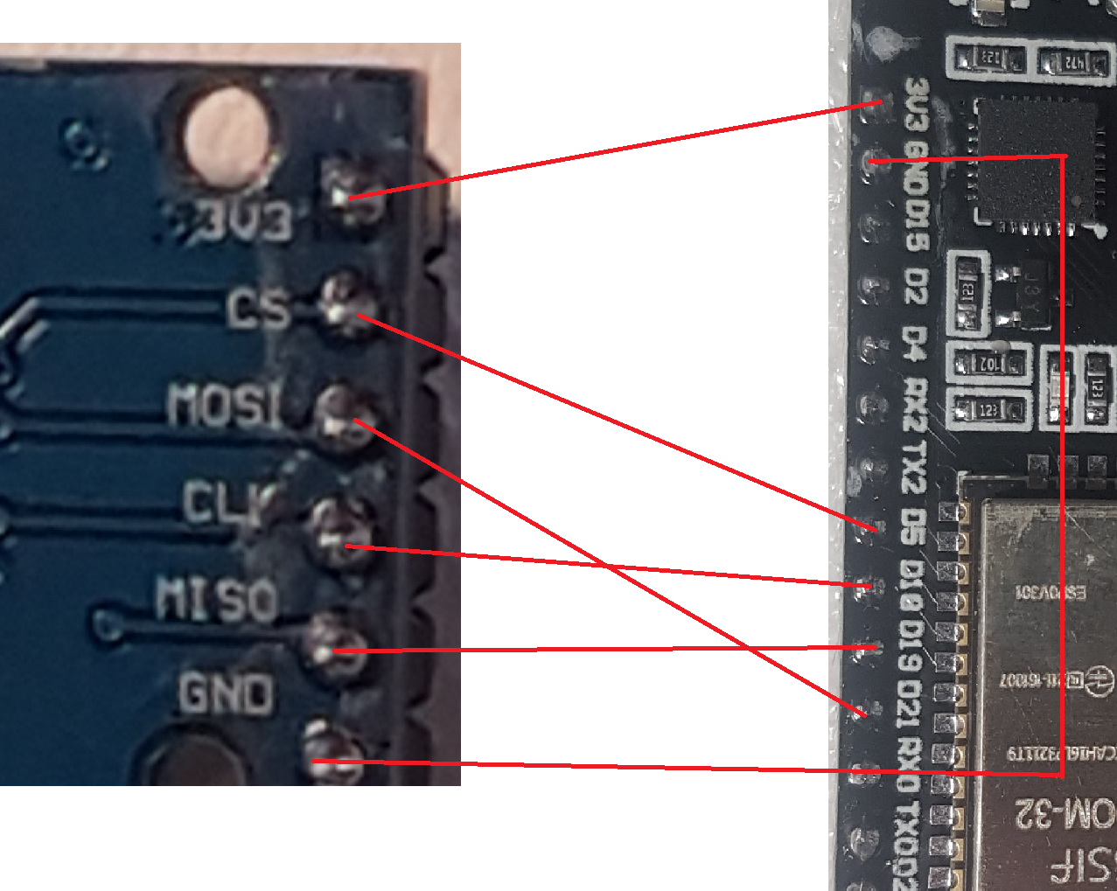
Sd Cards
SSD | ESP GPIO
3V3 | 3V3
CS | 5
MOSI | 21
CLK | 18
MISO | 19
GND | GND

Slide 6
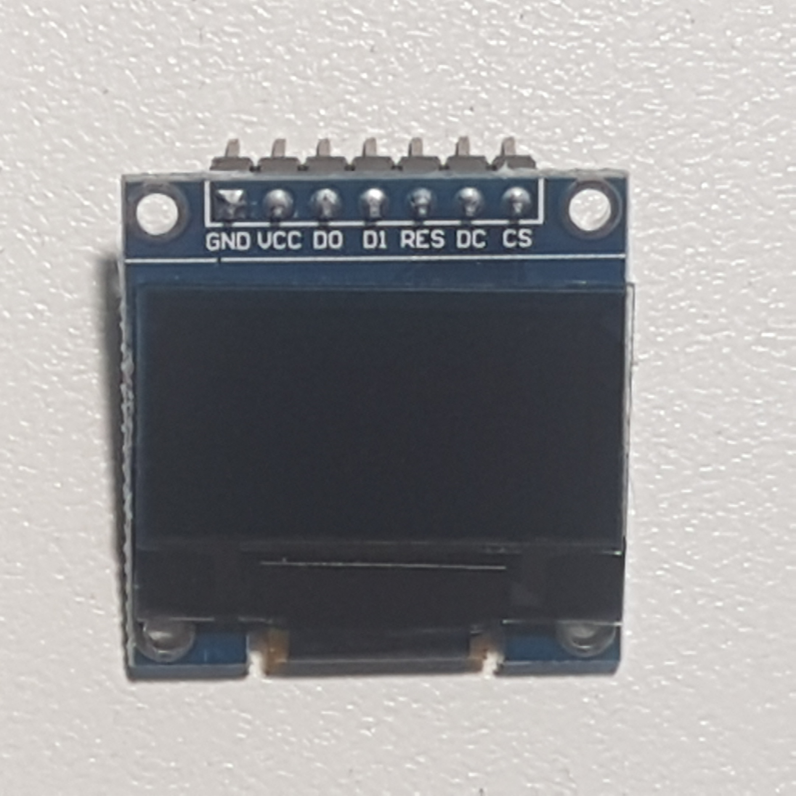
Pin mapping
SSD1306 | ESP SOI | ESP GPIO
GND | GND | GND
VCC | 3v3 | 3V3
D0 | SCK | 14
D1 | MOSI | 13
RES | RESET | 26
DC | Data command | 27
CS (Chip Select) | SS (Slave Select) | 15

